Slide 1
POWER
ability to influence the behavior of others or the course of events

Slide 2
Power Struggles in OUR World:
Man vs. Nature
Syrian Govt. vs. Syrian People
Al Qaeda vs. Western Society
Democrats vs. Republicans
Detroit Red Wings vs. Nashville Predators
Homeroom vs. Homeroom
Mr. K vs. Mr. Leathead
The Avengers vs. Loki
Bella vs. the Volturi
Students vs. Staff
Man vs. Law, Order
Man vs. Chaos

Slide 3
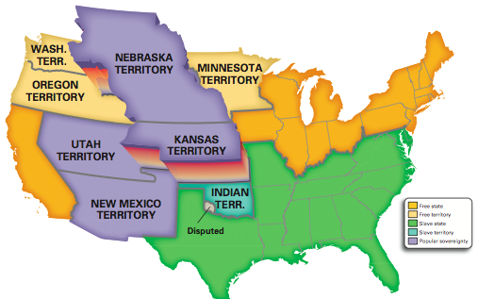
Slavery.
North vs. the South:
It’s all about slavery, right?
Legal? Illegal?
Ethical and Right? Unethical and Morally Wrong?
MORE IMPORTANT:
POWER struggle between North and South
Slavery is at its core
16 free states
32 Senators
15 slave states
30 senators

Slide 4
POWER Struggles We Need to Know
Between NORTH and SOUTH
ANTI- and PRO-SLAVERY GROUPS
Between PEOPLE and the FEDERAL GOVERNMENT
Popular sovereignty:
Political power belongs to the people
The people decide what the law should be

Slide 5
TODAY
You’ll need:
Your EQ answers from yesterday
Unit 7 Vocabulary
Ch. 15.1-15.2 Review
Textbook open to pages 484-485
Please get all of those out now and ensure that each of those is completed in the next 30 minutes.
Finally, complete the EQ Prep worksheet for EQ #3 as well as you can. We will review number 3 tomorrow.
HW Tonight: Read pages 488-492

Slide 6
EQ #1
Explain how the Wilmot Proviso increased sectional tensions between the free states and slave states.

Slide 7
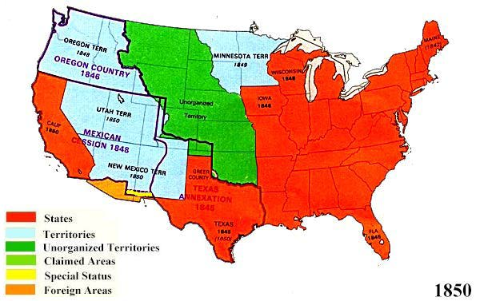
The HECK is the Mexican Cession?

Slide 8
The HECK is the Wilmot Proviso?
Document that stated:
SLAVERY is ILLEGAL in the Mexican Cession.

Slide 9
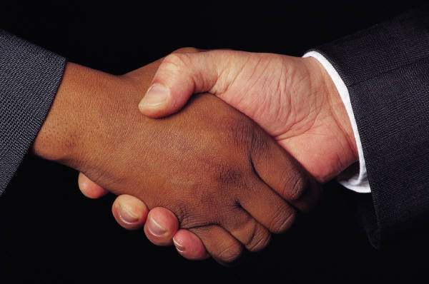
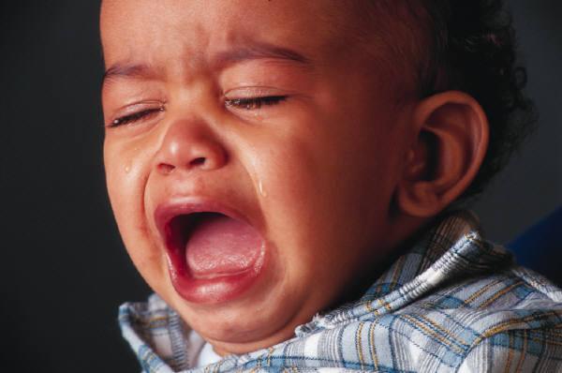
Two Sides to the Issue
NORTH:
LOVED IT
SOUTH:
HATED IT

Slide 10
EQ #1: In Brief
Slavery banned in Mexican Cession;
North loved this idea!
South hated this idea!
North/South voted for their side, regardless of their pol. party

Slide 11
EQ #1
The Wilmot Proviso was especially important in increasing sectional tension between the free states and slaves states.
Originally, it suggested that slavery be banned altogether in the Mexican Cession (which outrages pro-slavery southerners).
It passed the northern-controlled House (filled with Whigs and Democrats alike) but failed to pass the southern-controlled Senate.
Up until this point, congressmen tended to support party views and not the views of their region; but now, there is a major paradigm shift.
Congressmen begin to support their region’s views over their overall party’s agenda. This became further proof that the northern states and the southern states were beginning to separate more and more.

Slide 12
EQ #2
Explain how the Compromise of 1850 and the Fugitive Slave Act increased sectional tensions between the free states and slave states.

Slide 13
The HECK is the Compromise of 1850?
The Comp. of 1850 was proposed by Henry Clay (the same guy who helped with the Missouri Comp.)
California became a FREE STATE
Mexican Cession’s slavery issue decided by popular sovereignty
Slave trade outlawed in Washington, D.C.
Fugitive Slave Act became law

Slide 14
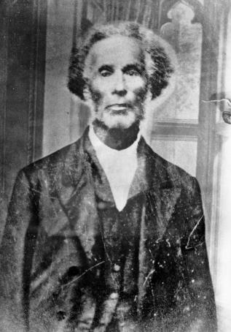
The HECK is the Fugitive Slave Act?
Made it a crime to help runaway slaves
Allowed officials to arrest those slaves in free areas
Allowed officials to return slaves to owners
Adam Crosswhite, anyone?

Slide 15
EQ #2: In Brief
SOUTH disagreed with northern free states having more power in Congress
NORTH disagreed with the Fugitive Slave Act

Slide 16
EQ #2
The Compromise of 1850 seemingly settled the differences between the northern and southern states but it did not help either side find a true agreement; rather, it, too, increased sectional tensions.
The Compromise of 1850 allowed for one more free state over the slave states (which may have upset southerners) and it also allowed for the very strict Fugitive Slave Act (which abolitionists and many northerners saw as awful).

Slide 17
TODAY
You’ll need:
Your EQ answers from yesterday
Unit 7 Vocabulary
Ch. 15.1-15.2 Review
Textbook open to pages 484-485
Please get all of those out now and ensure that each of those is completed in the next 30 minutes.
Finally, complete the EQ Prep worksheet for EQ #3 as well as you can. We will review number 3 tomorrow.
HW Tonight: Read pages 488-492

Slide 18
EQ #3
Explain how the Kansas-Nebraska Act and Bleeding Kansas increased sectional tensions between the free states and slave states.

Slide 19
What the HECK is the Kansas-Nebraska Act?
A plan to divide the remainder of the Louisiana Purchase into two territories: Kansas and Nebraska
Popular sovereignty would decide the issue of slavery
This would nullify the Missouri Compromise’s ban of slavery above the 36^{O} 30’ line
What’s the problem, then?
16 free states
32 Senators
15 slave states
30 senators

Slide 20
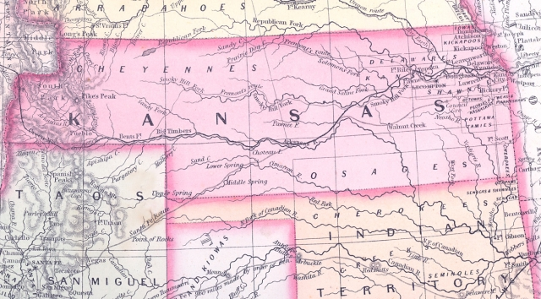
Bleeding Kansas
Northerners and abolitionists feared the worst!
These new territories originally declared slavery illegal but now Congress legalized it!
Pro- and anti-slavery groups rushed to Kansas to vote
There was a pro-slavery majority and Kansas became a slave state

Slide 21
Bleeding Kansas
In May 1856, 800 pro-slavery men rode to Lawrence, Kansas
They looted, burned, and destroyed much of the property in the “anti-slavery” town
One man died
A POWER STRUGGLE

Slide 22
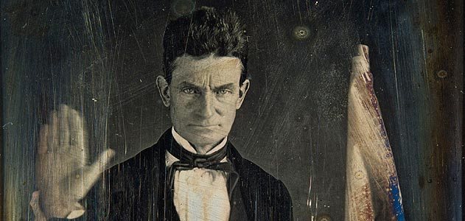
Bloody Kansas and John Brown
Soon after, John Brown and abolitionist supporters killed five pro-slavery men at Pottawatomie Creek
Kansas broke out in its own civil war
200 people died over the issue of SLAVERY

Slide 23
EQ #3: In Brief
Slavery in K and N decided by popular sovereignty
Upset abolitionists: did not guarantee abolition in K and N
Two more slave states meant that pro-slavery states would have more power than free states
John Brown’s wildly upset pro-slavery southerners

Slide 24
EQ #3
The Kansas-Nebraska Act did not guarantee either side success in that the decision to support slavery was up to the people of each territory; however, pro-slavery supporters rushed into the territories to vote for slavery.
This upset abolitionists in wild ways as it ensured that there would possibly be two more pro-slavery states represented in the U.S. legislature.
Soon enough, John Brown’s attacks on pro-slavery sympathizers pushed southerners to a breaking point.

Slide 25
POWER STRUGGLE
BETWEEN
NORTHERN FREE STATES
and
SOUTHERN SLAVE STATES

Slide 26
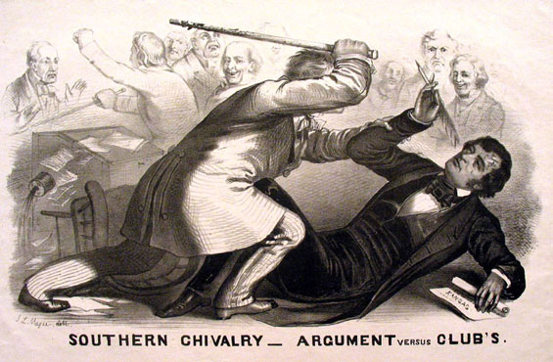
Attack in the Senate Chambers
Charles Sumner (MA) vs. Andrew Pickens Butler (SC)
2 days later…
Preston Brooks (SC and relative to Butler) vs. Sumner
CANE SMACKDOWN

Slide 27
TODAY and TONIGHT:
Review pages 488-492!
Prepare your response to EQ #4 (Dred Scott)

Slide 28
EQ #4
Explain how the Dred Scott decision increased sectional tensions between the free states and slave states.

Slide 29
Who was Dred Scott?
A slave owned by Dr. John Emerson of St. Louis, MO
Scott accompanied Dr. Emerson on tours of duty in Illinois and Wisconsin Territory
Places where slavery was illegal
Dred Scott later sued for his freedom, claiming he had become free when living in free territory

Slide 30
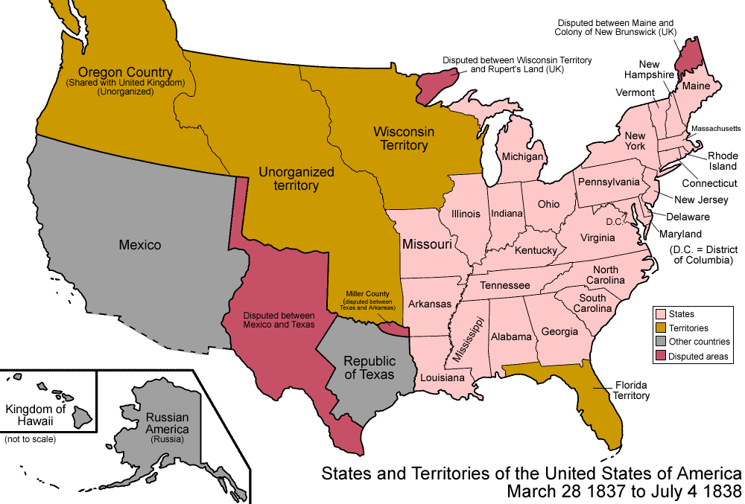
Dred Scott’s Travels
FREE
FREE
SLAVE
SLAVE

Slide 31
Was Dred Scott Free?
Scott argued YES! I AM! I lived in free territory where slavery is illegal; therefore, I could not have been enslaved.
The courts (including the Supreme Court) argued differently, though.

Slide 32
Chief Justice Taney’s Ruling
Was Scott a citizen?
Only citizens can sue in federal court
Did Scott’s time on free soil make him free?
Can Congress legally prohibit slavery in parts of the Louisiana Purchase (or any federal territory)?

Slide 33
Chief Justice Taney’s Ruling
African Americans “had no rights which a white man was bound to respect.”
All African Americans, whether slave or free, are not citizens
Scott, who is now not a citizen, cannot sue in court
This was enough to throw the case out

Slide 34
Chief Justice Taney’s Ruling
Scott’s time on free soil did not make him free, because he was a slave under Missouri law
(he ended up in Missouri)

Slide 35
Chief Justice Taney’s Ruling
Finally, Taney declared that the Missouri Compromise’s restriction on slavery in federal territories was unconstitutional
Congress cannot ban slavery on federal land
No one can be deprived of “land, liberty, or property without due process of law”

Slide 36
The Nation’s Response
Southerners/Some Democrats
Northerners/Republicans
Hooray!
Congress can’t ban slavery in federal territory
Now, slavery can SPREAD!
We’ll have more POWER
No! Horrible!
If Congress can’t ban slavery in federal territory, slavery might spread!
We’ll LOSE POWER

Slide 37
EQ #4: In Brief
Dred Scott was a slave from Missouri
Chief Justice Taney’s ruling reinforced the strict Fugitive Slave Act and
It overturned all efforts by abolitionists to end slavery up to this point.
It overturned the Missouri Compromise, it increased the chance of the spread of slavery, and it declared that African Americans were not citizens.

Slide 38
EQ #4
The Dred Scott decision increased sectional tensions between the North and the South in many ways.
Overall, Chief Justice Taney’s ruling reinforced the Compromise of 1850’s strict Fugitive Slave Act and basically overturned all efforts by abolitionists to end slavery up to this point.
It overturned the Missouri Compromise,
it increased the chance of the spread of slavery,
and it declared that African Americans were not citizens.

Slide 39
EQ #5
Explain how changes in the political party system increased sectional tensions between the free states and slave states.

Slide 40
Change Over Time
The Democratic Party gained power in slave states and free states alike during the 1840s
Over time, the Democratic Party tended to lean more towards supporting slavery (in support of the South)
Northerners started feeling threatened
Why?

Slide 41
POWER
The North wanted to maintain POWER over the South
Just as the South wanted to maintain POWER over the North!

Slide 42
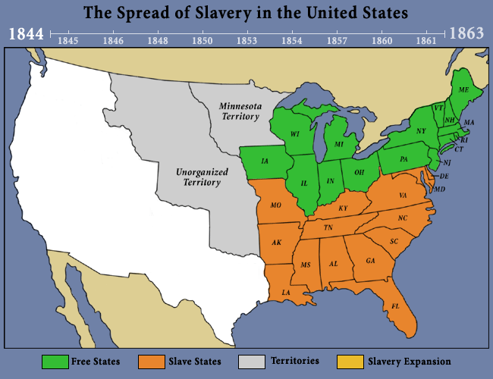
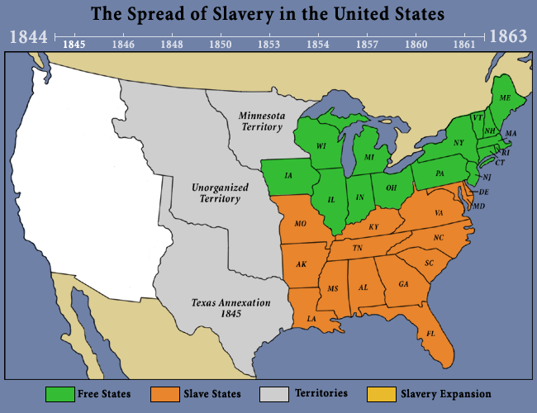
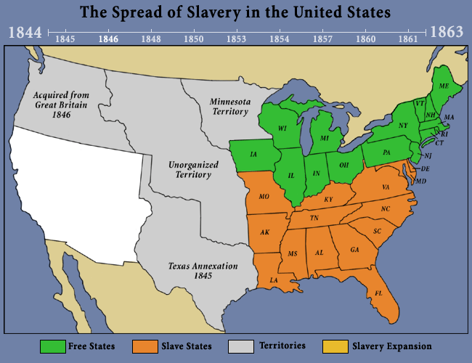
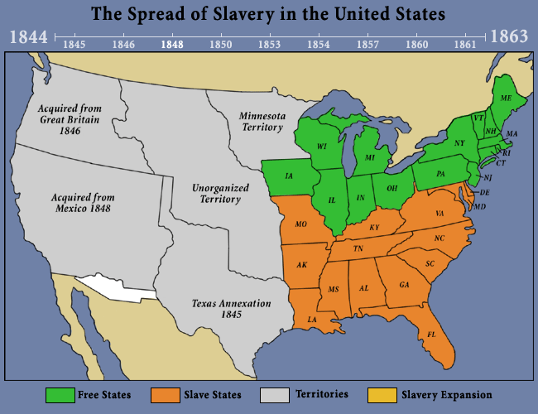
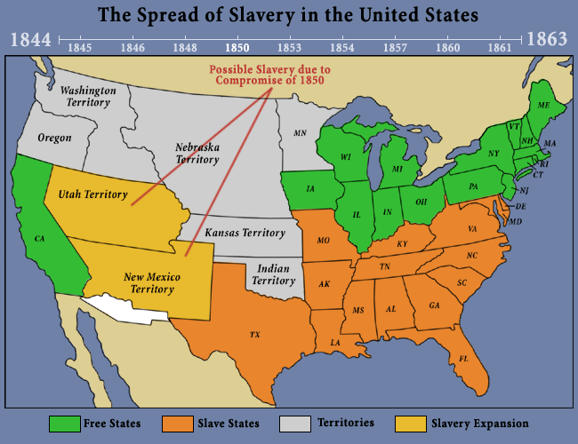
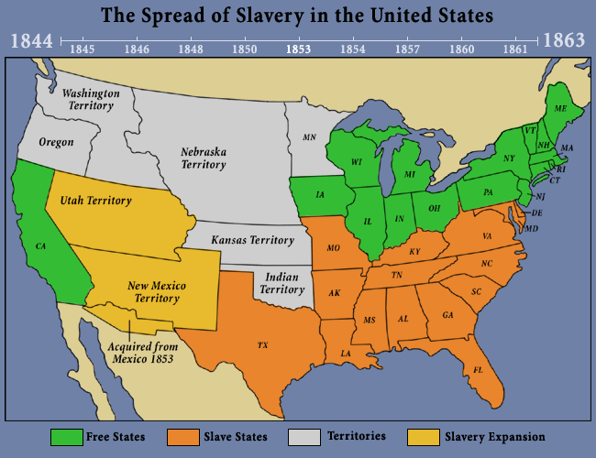
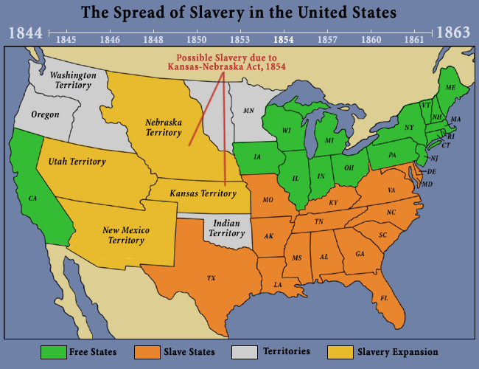
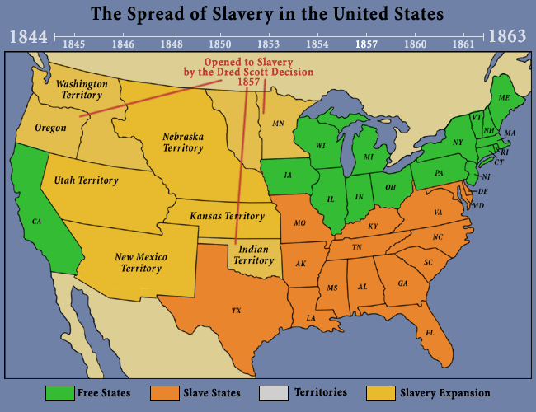
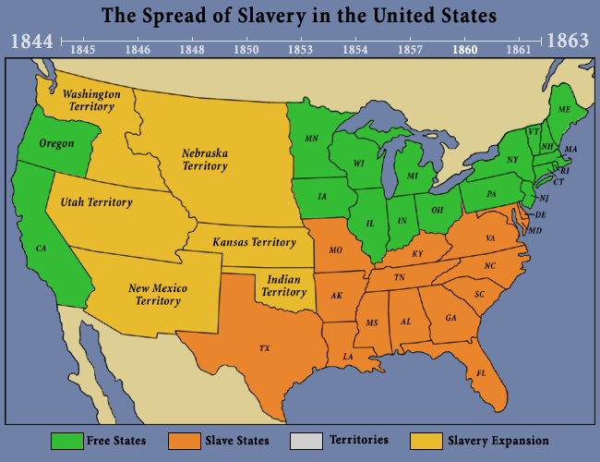
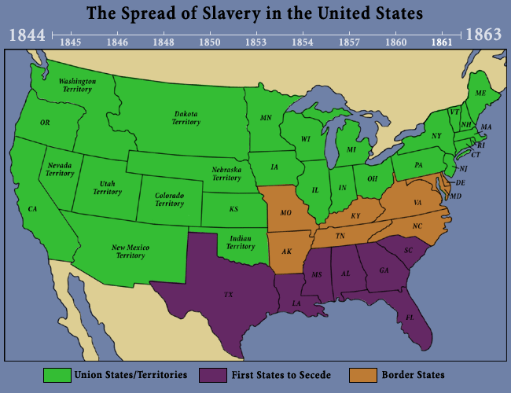
Northern States Rally
Northerners wanted to maintain POWER over the South!
Northerners/Republicans felt that by UNIFYING to block the spread of slavery would limit the South’s power in new territories and states

Slide 43
POWER
The first Republican Convention was held in July 1854, in Jackson, Michigan
Within FOUR YEARS Republicans dominated northern states
WHY?
POWER, Yo!

Slide 44
EQ #5: In Brief
The issue of THE EXPANSION OF SLAVERY caused changes in political parties
The Republican Party became a powerhouse in the northern states
Opposed the expansion of slavery
The Democratic Party became more popular in the southern states (because it tended to support the interests of slaveholders)
Supported the expansion of slavery
The Republican Party gained power in the West and wins the election of 1860
North maintains power over the South

Slide 45
EQ #5
The major change in the political party system that increased sectional tensions between the free states and slave states was the rise of the Republican Party growing out of the Whigs, abolitionists, some Democrats, and Free-Soilers.
The Republican Party became a powerhouse in the northern states and was a formidable foe against southern Democrats who tended to support slavery.
The growth of the Republican Party in Western states solidified its power and Won the presidency in 1860 under the leadership of Abraham Lincoln.
This was essentially the breaking point and many southern states seceded soon after (South Carolina seceded before Lincoln took office).

Slide 46
Tonight
Please read Chapter 15.4: The Nation Divides
Pages 493-397
Work on your Unit 10 Study Guide
Test is on Thursday!
You should complete your study guide by Wednedsay

Slide 47
EQs 4 & 5
#4 Explain how the Dred Scott decision increased sectional tensions between the free states and slave states.
#5 Explain how changes in the political party system increased sectional tensions between the free states and slave states.

Slide 48
Yo, History!
Please get out your Unit 10 Study Guides
Pick up one of the pieces of paper from up front AND ensure that you have a half-sheet “Warm-Up” on your table, too!
Please open your textbook to page 494

Slide 49
Abolitionist Violence: John Brown’s Raid!
October 16, 1859 - Night
John Brown AGAIN
Harpers Ferry, Virginia
Plan: Raid an armory and give weapons to nearby slaves

Slide 50
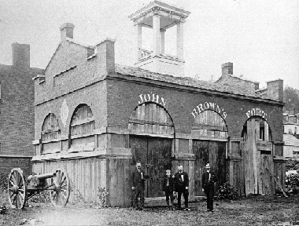
The “Firehouse”: John Brown’s Fort

Slide 51
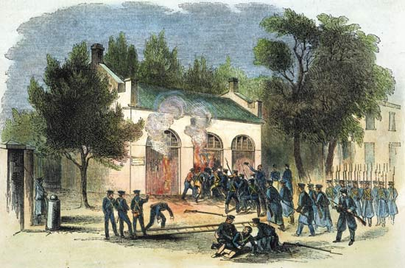
Marines Attack the Firehouse (the Armory)

Slide 52
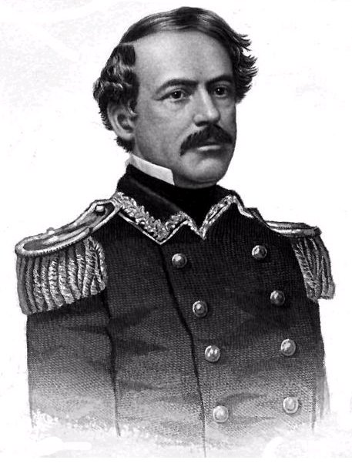
Brown vs. US Marines
Local white men retaliate and kill eight of Brown’s men
Brown retreats into the Armory’s firehouse
Federal troops (marines lead by Robert E. Lee) rush the firehouse, kill two more men, and capture brown

Slide 53
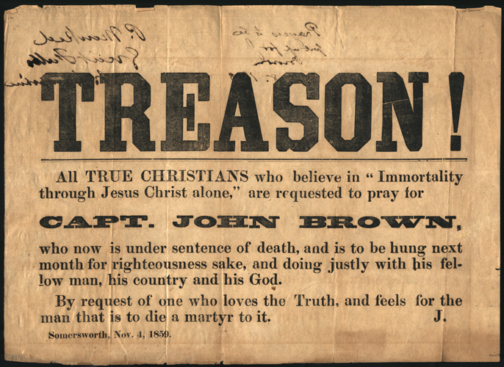
The Aftermath: Hanged on December 2, 1859

Slide 54
The Aftermath
How do southerners respond?
What were they afraid of?
What was Lincoln’s opinion on the matter?
Should abolition be a violent cause?
Can violence combat slavery effectively?

Slide 55
Election of 1860
Rise of the Republican Party
The Republicans unify behind ONE candidate:
Abraham Lincoln
Democrats split their votes between TWO candidates

Slide 56
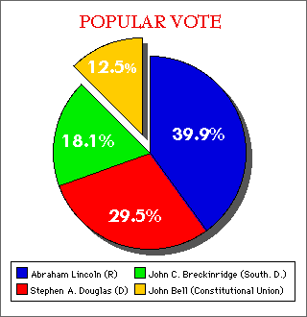
Election of 1860
With ONE candidate, the Republican Party easily wins the election
Southerners become very afraid
BUT WHY?!
WHAT DO THEY FEAR?

Slide 57
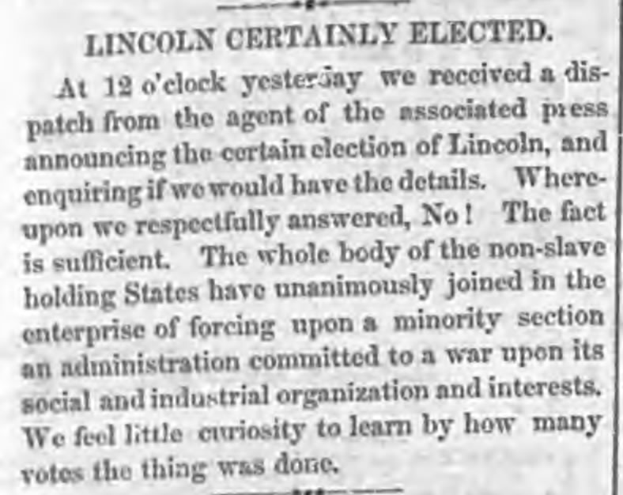
Opposition to Republicans and Lincoln

Slide 58
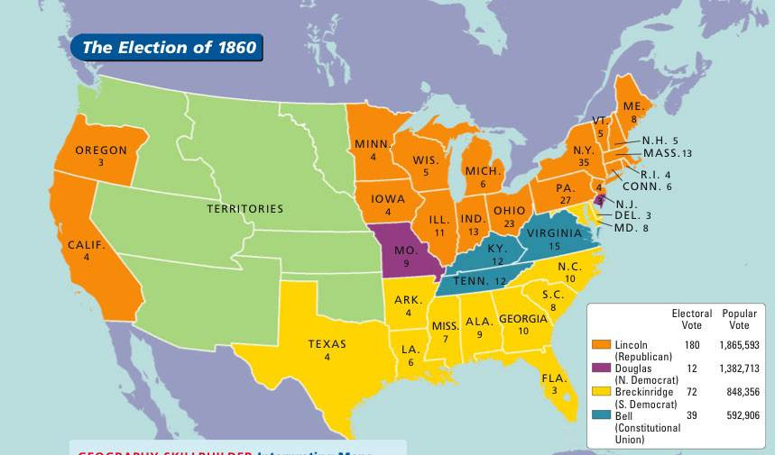
Election of 1860

Slide 59
Secession!
December 20, 1860 (one month after Lincoln is ELECTED – he hasn’t taken office yet!), South Carolina FORMALLY secedes from the United States
Lincoln and others never recognize this, it is illegal
Soon after (within a few months) other states secede, too
Texas, Mississippi, Florida, Alabama, Georgia, Louisiana
Later: Arkansas, North Carolina, Virginia, Tennessee

Slide 60
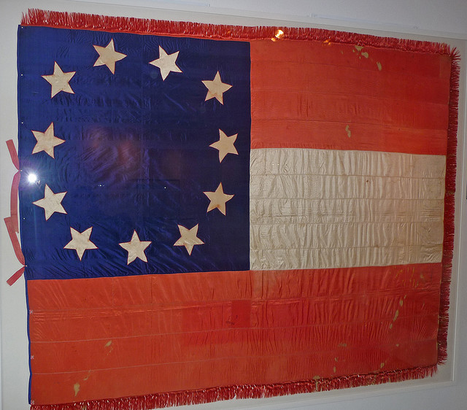
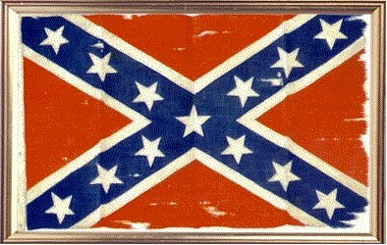
Confederate States of America

Slide 61
But WHY?!
Why did these states SECEDE?!
Why did they formally LEAVE the Union?
Five myths why the South seceded – Washington Post

